Slide 1
Structural and institutional racism against African American men in the justice system
PRESENTED BY
STUDENT NAME

Slide 2

introduction
The racial disparity in American jails is worrying.
Today one out of every four black men is likely to go to prison at one point in their lives.
In 2008, out of every 100,000 African American men, 2,272 were incarcerated, in contrast, only 392 men were in jail out of a similar sample size. (Bureau of justice. 2008)
Cases of police brutality, shooting of unarmed black men and boys have revived the discussion on the structural racism in the justice system.
This study was born out of the critical question; Why are so many black men and boys ending up behind bars?
Notes:
The American history is tainted with accounts of discrimination of African Americans, from the days of slavery, to the days of limited voting and property rights, black people have seemingly been disadvantaged by the system. While today we pride ourselves as a non racial community, government bodies and institutions still exhibit structural and institutional racism. The sheer number of African American men being taken into police custody has caused alarm. This research seeks to examine whether black men are ending up in jail due to structural and institutional racism in the justice system.

Slide 3
Research question
Is the American justice system promoting mass incarceration of African American men due to structural and institutional racism in system?
Notes:
This study will seek to answer this research question , by employing scientific methods of research design, research methods, data analysis and conclusions. The research will examine the parameters involves in this question, placing them within the context of the Justice system. At the final stage of this research paper, I will provide detailed arguments to affirm or invalidate this research question.

Slide 4
Literature review
A) Chronic Disparity: Strong and Pervasive Evidence of Racial Inequalities, by Keith and Terry
In this paper, the authors extensively discuss the concepts of structural and institutional racism.
Structural racism is defined as the acceptance and legalization of social parameters that accord white people advantages and privileges while oppressing black people and to an extent, other people of color.
Structural racism is characterized by white supremacy, inequality, special treatment of white people at the expense of people of color.
The authors examine the historical aspect of structural racism and how the vice has developed in America. (Keleher and Lawrence. 2004)
Notes:
Institutional racism is defined as discrimination and unequal treatment based on a persons ethnicity, especially minority or marginalized groups. Institutional racism is a result of systems, structures and expectations that have been normalized within an institution.
The authors draw our attention to the prevalence of the social vices in the justice system, how they have been normalized and how they affect black people; directly or indirectly.

Slide 5
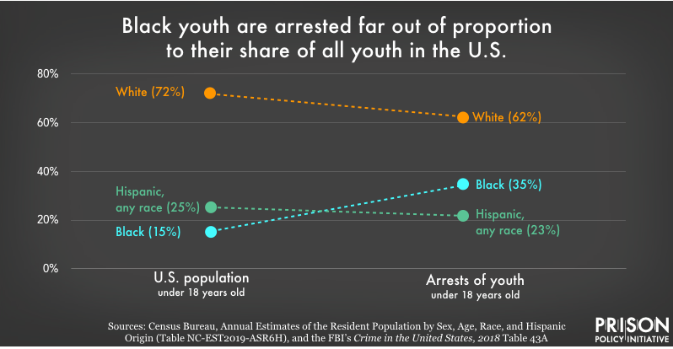
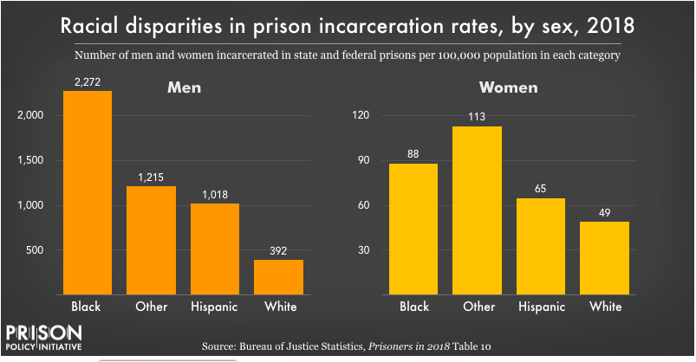
B) Visualizing the Racial Disparity in Mass Incarceration, by Wendy Sawyer
In her article, Wendy does a prolific job of painting the actual situation of how black men are being locked up by the masses.
Notes:
In 2018, 35% of all black male youth had a run in with the law enforcement officers
One in every four African American is likely to go to jail at some point in their lives
Of the 13% national population comprised of black men, 48% are serving life sentences with or without parole.
Black people represent the largest propotion of people on the death row

Slide 6
C) The Black Family and Mass Incarceration by Bruce and Christopher
The authors annotate the 1965 article by Moynihan that isolated the critical social issues that black people had to content with. The authors acknowledge the critical threat mass incarceration of black men poses to the family structure; especially in low-income black communities.
The authors examine the role of constitutional and justice system racism in sending black men to jail.
The article also examine the role of politicians in propagating structural and institutional racism in the justice system. (western and Wildeman. 2009)
D) Tupac's Law: Incarceration, T.H.U.G.L.I.F.E, and the crisis of black masculinity by Seneca Vaught
The author examines the issue of structural racism in America by examining the life, career and incarceration of Tupac Shakur, a Hip-Hop icon of the 90’s. The author examines the challenges black men face, how they are subjected to police brutality, a biased justice system and mass incarceration of black men
Notes:
Institutional racism is defined as discrimination and unequal treatment based on a persons ethnicity, especially minority or marginalized groups. Institutional racism is a result of systems, structures and expectations that have been normalized within an institution.
The authors draw our attention to the prevalence of the social vices in the justice system, how they have been normalized and how they affect black people; directly or indirectly.

Slide 7
Research hypothesis
Institutional and structural racism in the judicial system has played a critical role in the mass incarceration of African American men.
null hypothesis
Institutional and structural play no critical role in the mass incarceration of African American boys and men.
Notes:
The research hypothesis forms the basis for this research project. The hypothesis has been formed by the literature review of relevant pieces of literature, media coverage of controversial cases and research on the topic.
The null hypothesis is the alternate version of the research hypothesis, it is essentially antithesis of the research hypothesis.

Slide 8
Research variables
A) independent variables
Number of African American men arrested within a given period, reasons given for arrest, amount of bail set for white and black men
Comparisons of sentences for black and white male offenders for similar offences
Comparison of reported incidences of police brutality meted on black and white males.
B) dependent variables
Number of black and white men serving life sentences
Number of black and white men who successfully appeal their sentences successfully
Number of black and white men committing suicide in prison
Notes:
Independent variables are basically the cause while dependent variables are the effects arising from the independent variables. Independent variables are directly influenced by the structural and institutional racism within the justice system. On the other hand, the dependent variables are the implications of the racism in the justice system.

Slide 9
Research design
For this research, I will use the Case study design.
The case study research design is important in narrowing down the broad research topic to a small focus area
I will isolate specific cases that have gained media popularity as they fall under the criteria for research
Case study design provides a critical analysis and explanation of the research interest.
It is important for building on the knowledge that I have gained from review of literature and preliminary research on the topic.
Notes:
The case study research design is instrumental for social research and analysis. Since most social pattern fall within a specifies pattern, the research design enables the researcher to critically analyze selected cases to derive conclusions and test the research hypothesis and questions.
However, Case study design has an apparent weakness. Cases isolated might not represent the actual issues and parameters of the other cases and incidents.

Slide 10
Sampling method
This study will use the non-probability purposive or judgmental sampling method.
Purposive sampling entails using knowledge acquired from preliminary research and secondary sources to isolate cases that fit a preset pattern.
I will isolate cases that exhibit pattern of racial and institutional racism, cases that have gained wide media coverage and have been subject for academic debates and discussion will also be picked for a detailed examination.
Purposive sampling will allow me to focus my attention to cases which might contain relevant information to test my research hypothesis and questions,
Notes:
There are two categories of sampling methods; probability and non-probability sampling. Probability sampling is mostly used in qualitative data which involves the use of statistical data. On the other hand, non-probability sampling is used in qualitative research, one that examining the critical aspects of a research subject, making note of in depth meaning of research subjects or text under study.

Slide 11
Data analysis method
For this research, I will use the grounded theory of data analysis.
The theory entails critically studying and analyzing a specific research subject or case to prove or disapprove a research hypothesis or questions.
I picked the grounded theory because it requires a researcher to disregard any possible bias and preformed opinions about the cases chosen for study.
The grounded theory provides a systematic and stratified classification of inferences, providing detailed observations and explanations that ultimately lead to drawing of concrete and scientifically proven conclusions.
Notes:
Qualitative research entails a critical analysis of data and research subjects. Data analysis methods in this type of research mainly bank on the researcher’s experience, expertise and knowledge of the research subject, based on secondary data sources.
Common methods of qualitative data analysis include content analysis and hermeneutic data analysis.

Slide 12
Application of the study to social work practice
Social workers can use this research to advocate for social change by drawing the public’s and leaders’ attention to the issue of African American men being imprisoned due to structural and institutional racism.
Through this research, social workers and human rights activists can gain critical knowledge on the workings of the judicial system, and how it handles black men.
Social workers dealing with black children from poor black communities can use this research to better offer guidance and counselling to children in households that have lost their fathers to incarceration
Notes:
Social work fundamentally entails driving positive change in society by creating awareness of contentious social problems. It also entails advocating for social and systematic change in public service institutions to ensure that every person gets a fair treatment; despite their race, ethnicity, religion, sexuality, and any other characteristics that set them apart.

Slide 13
conclusion
While racism has taken new forms over the years, it still affects the way African Americans are treated today.
Publicized incidents of white cops killing unarmed balck men and boys have grabbed the public’s attention over the years; with many people questioning the motive for killing these unarmed citizens.
More research should be done on this subject to better understand the structural and institutional racism prevalent in our country’s justice system
The government should implement radical changes in the justice system to weed out any public servants who discriminate African Americans; consequently denying the fundamental right of a free and fair trial.

Slide 14
references
Lawrence, K., & Keleher, T. (2004, October). Structural racism. In Race and Public Policy Conference, Berkeley. Retrieved from http://www. intergroupresources. com/rc/Definitions% 20of% 20Racism. Pdf
Wendy, S. (2020) visualizing the racial disparities in mass incarceration. Prison policy initiative. Retrieved from: https://www.prisonpolicy.org/blog/2020/07/27/disparities/?gclid=Cj0KCQjwmIuDBhDXARIsAFITC_6Je0NdJIQL3O2rKL6qOd_-SnFMH7CyaZyaLip1QH4R9RvYctIC9ZUaApVkEALw_wcB
Western, B., & Wildeman, C. (2009). The black family and mass incarceration. The ANNALS of the American Academy of Political and Social Science, 621(1), 221-242.
Vaught, S. (2014). Tupac's Law: Incarceration, THUGLIFE, and the Crisis of Black Masculinity. Spectrum: A Journal on Black Men, 2(2), 87-115.

